Slide 1
Object Oriented Programming (OOP) I/O Communication

Slide 2
File
The data is stored on machine in form of a file.
File is a collection of related data.
Stored on some location, on the disk.
We can perform read and write operations on these files.
Two actions can be performed:
Data transfer between console and program.
Data transfer between program and disk file.

Slide 3
I/O Overview
IO provides communication with devices (files, console, networks etc.)
Communication varies (sequential, random-access, binary, char, lines, words, objects, …)
Java provides a “mix and match” solution based around byte-oriented and character-oriented I/O streams – ordered sequences of data (bytes or chars).
System streams System.in, (out and err) are available to all Java programs (console I/O) – System.in is an instance of the InputStream class, System.out is an instance of PrintStream
So I/O involves creating appropriate stream objects for your task.

Slide 4
The I/O Zoo
More than 60 different stream types.
Based around four abstract classes: InputStream, OutputStream, Reader and Writer.
Unicode characters (two bytes per char) are dealt with separately with Reader/Writers (and their subclasses).
Byte oriented I/O is dealt with by InputStream, OutputStream and their subclasses.

Slide 5
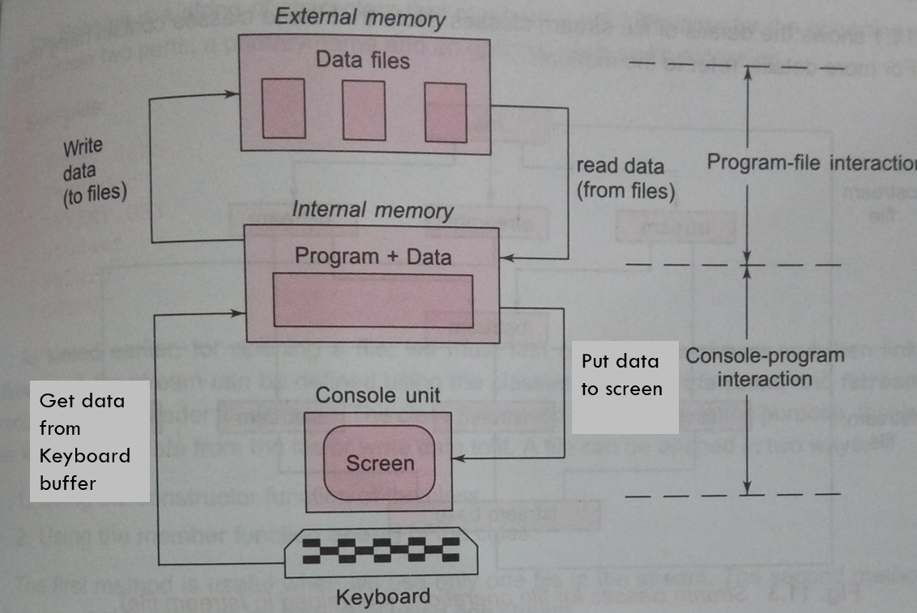

Slide 6
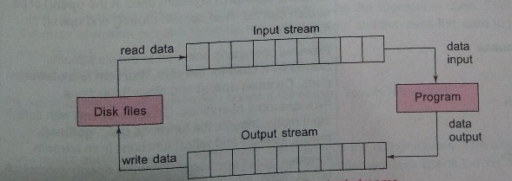

Slide 7
File Processing
Typical pattern for file processing is:
OPEN A FILE
CHECK FILE OPENED
READ/WRITE FROM/TO FILE
CLOSE FILE
Input and Output streams have close method (output may also use flush)

Slide 8
Create or Open A file
The File class of the java.io package is used to perform various operations on files and directories.
There is another package named java.nio.
we need to import the java.io.File
Syntax :
File file = new File(String pathName);
To create a file in Java, we can use the createNewFile() method.
File myObj = new File("filename.txt");
if (myObj.createNewFile())
{
System.out.println("File created: " + myObj.getName()); }
else
{
System.out.println("File already exists."); }
To create a file in Java, you can use the createNewFile() method.

Slide 9
May encounter error (complete code)
public static void main(String[] args) {
try {
File myObj = new File("filename.txt");
OR
File myObj = new File("C:\\Users\\MyName\\filename.txt");
if (myObj.createNewFile()) {
System.out.println("File created: " + myObj.getName());
}
else {
System.out.println("File already exists."); }
}
catch (IOException e) {
System.out.println("An error occurred.");
e.printStackTrace();
}
}

Slide 10
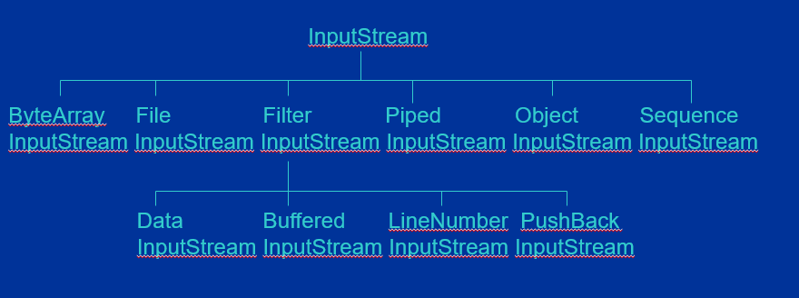
InputStream hierarchy

Slide 11
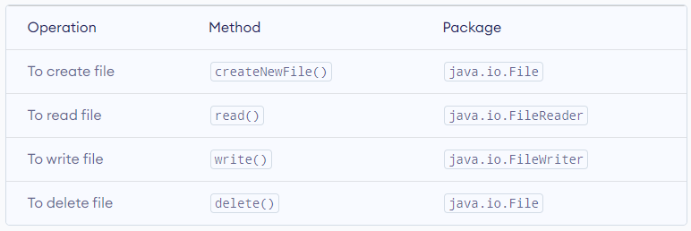
Java File Operation Methods

Slide 12
Writing Bytes
In the following example, we use the FileWriter class together with its write() method
Syntax:
void write(int b) - writes a single byte to an output location.
Java IO programs involve using concrete versions of these because most data contain numbers, strings and objects rather than individual bytes.

Slide 13
Example
import java.io.FileWriter;
import java.io.IOException;
try {
FileWriter myWriter = new FileWriter(“input.txt");
myWriter.write("Files in Java might be tricky, but it is fun enough!");
myWriter.close();
System.out.println("Successfully wrote to the file.");
}
catch (IOException e) {
System.out.println("An error occurred.");
e.printStackTrace();
}
}

Slide 14
Reading Bytes
Abstract classes provide basic common operations which are used as the foundation for more concrete classes, eg InputStream has
int read( ) - reads a byte and returns it or –1 (end of input)
int available( ) – num of bytes still to read
Concrete classes override this method, eg FileInputStream reads one byte from a file, System.in is a subclass of InputStream that allows you to read from the keyboard

Slide 15
Read A file
char[] array = new char[100];
try {
FileReader input = new FileReader("input.txt");
input.read(array);
System.out.println("Data in the file:");
System.out.println(array);
input.close();
}
catch(Exception e) {
e.getStackTrace(); 4816
}
}

Slide 16
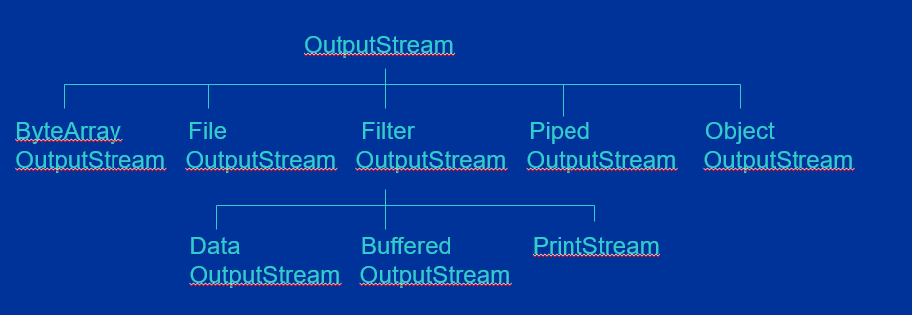
OutputStream hierachy

Slide 17
Delete a file
import java.io.File;
public static void main(String[] args) {
File file = new File("file.txt");
boolean value = file.delete();
if(value) {
System.out.println("The File is deleted.");
}
else {
System.out.println("The File is not deleted.");
}
}

Slide 18
Object Streams
So far we have dealt with fixed length records, what if we treat the classes as objects and write them all to disk.
To save object data we need to open an ObjectOutputStream object:
ObjectOutputStream out = new ObjectOutputStream(new FileOutputStream(“scores.dat”));
Now saving objects is easier using writeObject and readObject.

Slide 19
Object File
The previous code can be simplified if we rewrite it using object streams – now the array of records can be written/read in one single operation
Note: we have to make the Scores class implement the Serializable interface.
The serialization file format is more expensive than the text format.
Serialization is a process to convert objects into a writable byte stream.
Serializable is an interface that converts the object into a stream of bytes.
import java.io.Serializable

Slide 20
Example
import java.io.FileInputStream; import java.io.FileOutputStream; import java.io.ObjectInputStream;
import java.io.ObjectOutputStream; import java.io.Serializable;
class Dog implements Serializable {
String name;
String breed;
public Dog(String name, String breed) {
this.name = name;
this.breed = breed;
}}

Slide 21
class Main {
public static void main(String[] args) {
// Creates an object of Dog class
Dog dog1 = new Dog("Tyson", "Labrador");
Dog dog2 = new Dog(“Bill", “Bull Dog");
try {
FileOutputStream f = new FileOutputStream(new File("myObjects.txt"));
// Creates an ObjectOutputStream
ObjectOutputStream out = new ObjectOutputStream(f);
System.out.println("Dog Name: " + newDog.name);
System.out.println("Dog Breed: " + newDog.breed);
output.close();
input.close();
}
catch (Exception e) {
e.getStackTrace();
}
}
}

Slide 22
Writes objects to the output stream
out.writeObject(dog1);
out.writeObject(dog2);
out.close();
f.close()

Slide 23
Read Object
FileInputStream fi = new FileInputStream(new File("myObjects.txt"));
ObjectInputStream oi = new ObjectInputStream(fi);
Dog newDog1 = (Dog) oi.readObject();
Dog newDog2 = (Dog) oi.readObject();
System.out.println("Dog Name: " + newDog1.name);
System.out.println("Dog Breed: " + newDog1.breed);
output.close();
input.close();
} catch (Exception e) {
e.getStackTrace();
}

